Slide 1
Leveraging AI from Idea to Scale
Muktabh Mayank Srivastava
Co – Founder and Chief Data Scientist,
ParallelDots Inc.
Talk at SIBM, Pune – July 2025

Slide 2
What I am assuming about the audience
You either want to build an AI startup as an entrepreneur
Or you want to build an AI product or feature at a traditional company or business to drive efficiency as a product manager.
Or you are generally interested in how AI effects businesses.

Slide 3
Why should you listen to me ?
Have tried multiple things in AI [Even before times when AI was considered cool]. From news recommendation in mid 2010s to medical AI in late 2010s to retail industry.
Products : News Recommendation – 2014 AI based Social Media Analytics [Karna AI] – 2016 Radiologist AI tool [diagnosis.io] – 2017 AI based app to create and rate viral selfies [Cornea AI] - 2017 Dental cavity detection for helping dentists [Dentistry AI] – 2018 Shelfwatch [our current business] – 2019 onwards
A lot of things did not work out. Sometimes the technology was very hard to build [Cornea AI]. Building AI was possible for other things, but that’s not the hardest part IRL. Many industries don’t have the money to pay, many industries are built to be hard-to-disrupt, sometimes you make mistakes.
So will try to tell you what really works and what doesn’t.

Slide 4
ParallelDots today [2025]
Has raised over 6.5 Million dollars.
Shelfwatch analyzes about 4 Million images / videos from around a Million stores every month to inform CPG companies and retailers about their retail execution.
Retail Execution is metrics like On Shelf availability and Share of Shelf of various products.
Our clients include BlueChip companies like Mondelez, Kraft Heinz, British American Tobacco, ITC, Bacardi and many other names you would have heard of.

Slide 5
Three parts to my presentation [Mostly based on my experiences]
About AI | Building an AI business | Building an AI product
- Generally useful | - Useful to those looking to build an AI startup | - Useful to those who want to build an AI product
What is AI ? | How are early-stage startups different from established businesses ? Points to remember while building an AI startup | Early Product vs Early Utility aka How should your MVP look like ?
What all can you do with AI ? | Pivots and PMF | How to develop AI technology ?
How its impacting businesses ? | Moats in an AI startup | How to run your team ?

Slide 6
What is AI ?
Normies used to think Alexa and Google Home are AI till before ChatGPT, Gemini and DeepSeek arrived. So in a way they think computers responding to your messages in natural language is AI.
That’s not how I define AI. There are things computers are good at : storing files, doing arithmetic, running programs and there are things they were (until very recently) not good at : Understanding images, playing chess, teaching you math, writing code, holding conversations. AI is when you enable computers to do things like these.
Things like recommending a product on e-commerce, recognizing what items are on a shelf, understanding mood on social media, Alexa like IVR were what we could do until recently.
LLM like technologies are possibly the first time that a person with no technical expertise can operate an AI and use it to accomplish stuff. That is why they are so ground breaking.

Slide 7
What you could do with AI in 2025 ?
You could build a ParallelDots competitor :D , but that you could do in 2019 as well. What’s new for your generation ?
With LLM like generative AI technology, the current utility which is most obvious is to use it to “create”. Coding with programming models, books, videos / images with diffusion models. Automated speech transcription, automated translation is now at everyone’s fingertips. <You could for example make a Mahabharat movie alone in 1 year with nothing but either a good desktop or a Google Veo subscription>.
The other thing you could do is to build tools to help others create with AI. Cursor’s AI programming tool for example has a ARR of 500 Million USD, doubling every 2 months. MidJourney, ElevenLabs are other examples.

Slide 8
What you could do with AI in 2025 ? [examples]
Products and Businesses creating using AI [Recurring, not 1 time ! ] | Products and Businesses helping others create [or apps too modern for oldies to understand]
AI based B2B content creation / social media marketing agencies, faster and cheaper ! Or Businesses helping content creators / photographers have better visual effects. | Midjourney counterparts for India. There are not a lot ways to create “Indian feeling AI content”. Audio / Video and Images.
AI based companies, where AI/agent usage helps you drop costs of a service substantially. Say AI cataloging for e-commerce, or writing custom web crawlers using AI. | On consumer side : AI ABCD tools. ABCD sells in India. [A -> Astrology, B -> Bollywood, C-> Cricket, D-> Devotion]. Help people create ABCD with AI.
Helping pharma companies with new molecules using AI in specific domains or manufacturing companies with new materials or semiconductor companies with design. [Scaling expertise of senior folks with AI]. | If you are good at product and UX, think of what SaaS Indian startup playbook was. Cost effective copies of already successful AI products to be sold in India and abroad. Simple safe bet !
Creating better edtech material and experience using AI. | Millennials are clueless about their juniors, good time to imagine Gen Z, Gen Alpha AI consumer apps.

Slide 9
How is AI impacting businesses ?
SaaS is stagnant as of today. Maybe wrongly, but investors and customers all think its dead. They are desperate to make AI pivots.
IT companies are afraid of AI impact. They will make their employees upskill in AI tools and increase productivity. Expect less hiring!
There is pressure to adopt AI everywhere, use that to your advantage. Don’t worry about jobs becoming obsolete ! Useless pressure.
Get into the usual jobs with the AI twist. If you are getting into QA Engineering, for example, learn using AI for QA Engineering. Look into mobile and desktop agents and how to use them.
Consumer businesses will not be that effected, neither would be sales. “Distribution is STILL the king !”

Slide 10
Building new AI companies
From my experience, its both getting easier and harder.
Easier because potential clients want and need to use AI, so there is pre-existing demand. You wont have to answer questions like what is AI or get into comparisons between AI and SaaS pricing now.
Harder both because the barrier to entry has become lower AND its much costlier to do trial and error.
Remember how many products we tried to make in 2010s ? You won’t be able to raise money for so many now.
Remember, you needed a Computer Science [sometimes Masters] degree to build a AI product in 2010s, now its like SaaS. Self taught enthusiasts are good enough!

Slide 11
Building new AI companies – rules of thumb !
Try not entering businesses in regulated and controversial spaces [Health, defense, genetics] unless you have domain experts in your team. Building tech and business are great challenges, these add a 3rd complexity of navigating the space and earning trust before results.
Don’t build a business just on APIs. It has almost never ended well. API businesses have no moat ! Ok to integrate APIs in existing business workflows.
Always keep your goal as a business in mind. Its revenues [or usage if its consumer app] ! It will be hard in India to build a DeepMind/DeepSeek like company where the outcome is “great algorithms”. There is no ecosystem for anything apart from “something that makes money”.
You’re not building an algorithm, not building tech, not building an app. You are building a revenue stream / user utility where tech/algorithms are your differentiator. Don’t build tech or product, solve users’ problems !

Slide 12
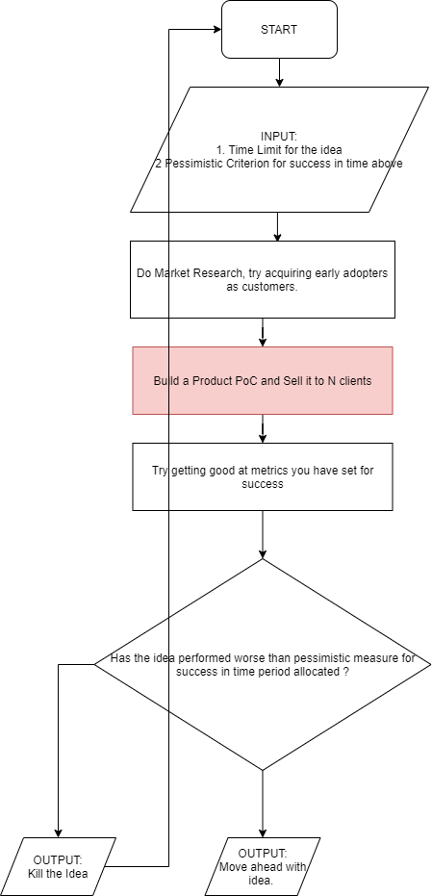
AI products : Pivots and PMF
Startups = Growth. Early startups= very fast growth.
Pivots are very important in creating a new business or successful products. You will almost never be right in your first attempt [or first few attempts]. Pivot fast enough to attempt at least 2 3 versions within your runway. Cut things fast ! Don’t stay on a version that looks “slow to sell!”.
Pivot cycle : Repeat (Market Research → Product PoCs → Letting customers choose you)
Don’t get into “Product perfection mode”. No you won’t be able to build a perfect product that would just sell on product’s merit in early stage. “Don’t strive for perfection. Strive for survival.”
Learn to sell MVP ! If MVP doesn’t sell, pivot.
What’s an MVP ? Something that solves the core issue you want to address, but isn’t something that does everything that potential user would ever want to do. If the core issue you want to solve is strong enough, you will find buyers, some and at discounted rates maybe, but you will find them. Small focused communities in consumer app.
These early adopters would help you build the remaining of your product as you integrate further in their lifecycle. That’s when you reach PMF.

Slide 13
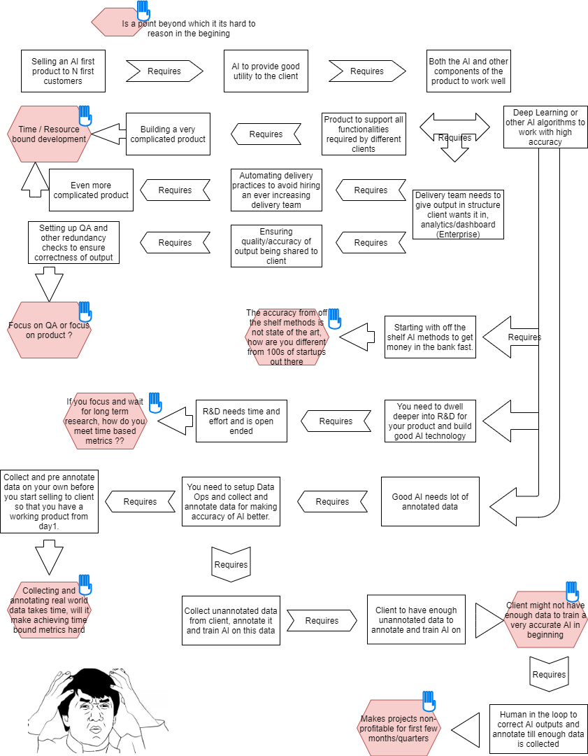
As a founder/product manager, its very easy to get overwhelmed. Too many variable, too less runway, almost always !
Remember your basic aim : “Solving a problem with AI that can be paid for / used regularly”
Use your judgement, cut things that aren’t relevant to above.
All feedback is welcome, use your judgement to understand which of it is useful. Remember its you who knows your product the best !
Its ok to do things that don’t scale initially. Don’t optimize prematurely. Solve a problem first. Worry about scaling it later when you have users to scale it with giving you feedback. [Paul Graham’s advice, not mine !]
Once you have scale, you need to repay back the unsustainable practices you adopted as a very high priority. [A lot of institutions fail due to this because power structures form around unsustainable practices and resist removal of such practices].

Slide 14
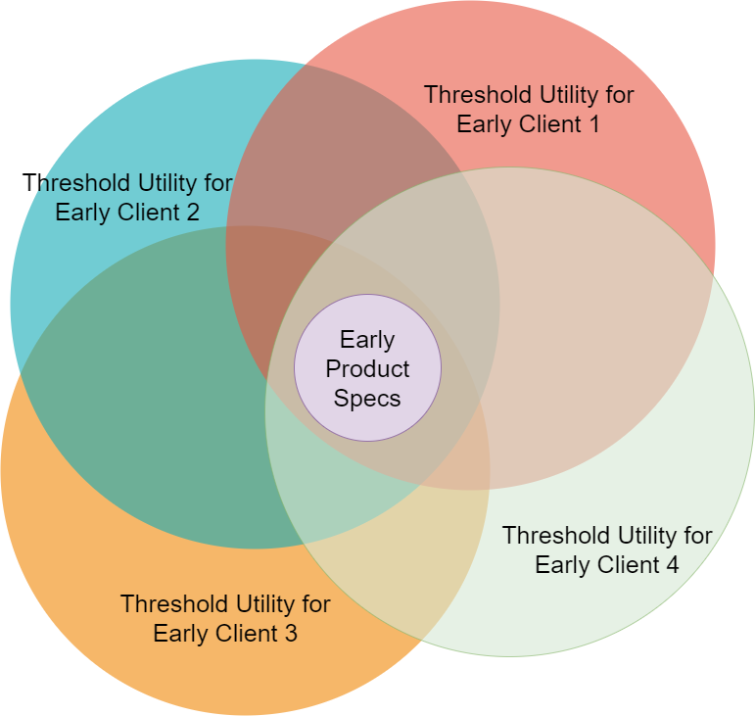
As a AI Product Manager: What’s your MVP ?
Its ok to do things that don’t scale in the beginning.
As long as there is a core AI functionality that helps you get usage and / or make money, build scaffolding around it and keep adding users.
Core AI functionality is what you should aim to get usage for. The MVP [core + scaffolding] is what you market and sell.
Developing scaffolding slowly becomes trivial when you scale the product up if it’s a product business and not services.
Let’s take an example of a user app you want to build to teach mathematics to kids.
The core RAG engine that identified the kids learning style and suggests the right materials and practice problems is the core product.
Whether you put it in your consumer app, in another white label app, on a school’s website, its all fine in beginning. Validate if its valuable. Always be ready to give exposure to your core.
Figure out later which of the channels to invest in and scale !

Slide 15
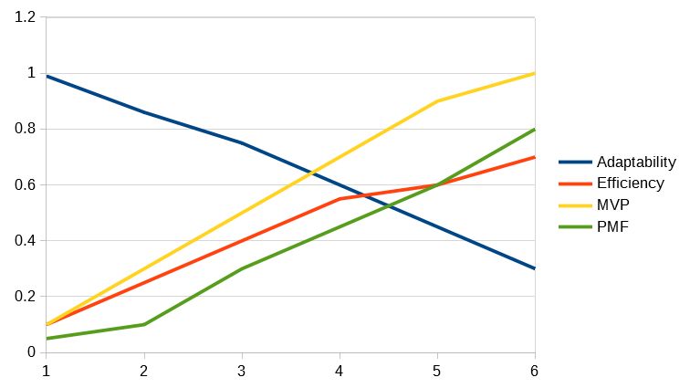
What changes with AI products with scale ?
The numbers on X, Y axis are just symbolic, all you need to understand that X axis is scale of usage, Y axis is importance.
MVP keeps growing in terms of features upto a certain level, until you figure out from market you don’t need to build any more core components.
PMF [Product Market Fit] is a scale at which the clients start buying your product for their belief in the idea and start buying it for the product’s virtue.
At small scale, you need to adaptable, but with scale you need to start thinking about efficiency.
In the sense, your team, your costs can be high per unit usage initially when you try to get as much usage as possible.
But as product usage grows you start to make sure that team size, server costs etc scale sub linearly.

Slide 16
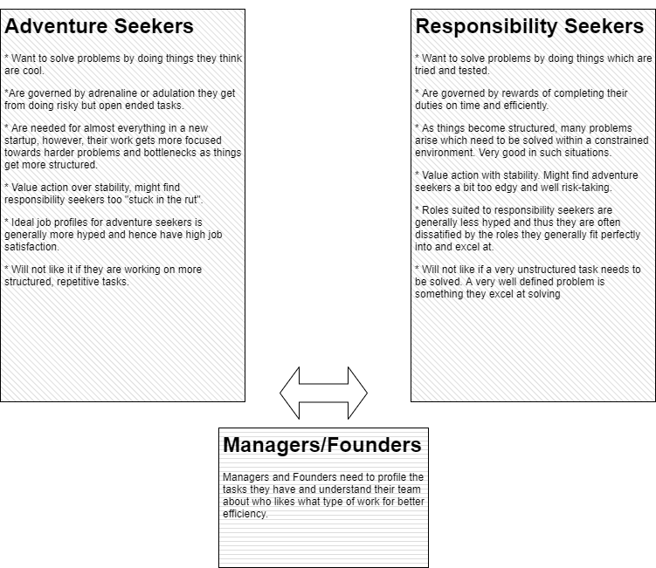
Hiring and managing an AI team
Learn to recognize both type of team members : Adventure Seekers and Responsibility Seekers.
Both are extremely valuable for different types of tasks.
Understand that most people want to BE adventure seekers because that is what startup thinking glorifies. That doesn’t mean they really ARE ones who can solve open ended stuff.
Responsibility seekers are extremely underrated. They build a business out of a wild idea. You need to work extra hard to keep them amped up as their self image is diminished due to cultural issues.
Recognize Adventure seekers and direct them to hard problems, recognize responsibility seekers and redirect them to rigorous regular tasks and metrics.

Slide 17
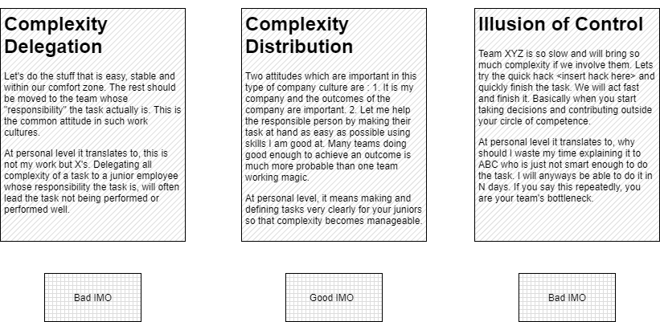
Hiring and managing an AI team
Not all team cultures are equal. Some are really bad !
Complexity Delegation is really bad! For example, product team not changing product design but asking AI team to build a much more complex model. Similarly, AI team not budging on model details but asking sales team to sell exactly what they have.
The right way is Complexity distribution. That is Founder or Product manager figuring out a middle path which is solvable by everyone. Requires both judgement and consensus building. Leaders are important you see !
Another Anti Pattern is Illusion of control. Some things are slower to scale, say AI as compared to product. Cannot omit AI team and scale just with product team hoping others to catch up.

Slide 18
Building the tech !
This is what I do everyday, but not sure if this is of a lot of interest to audience. But I will give some general points that are useful to everyone.
“Innovation is creativity in straitjacket of feasibility”. Remember that just because you can think of an AI product doesn’t mean it can be built. Sometimes it might be possible to build it, but not in a way you imagine, sometimes not at all. Very common issue in AI products is leaders high on their “vision” !
AI Technology is strange in a way that everything from scale 1 to 10 might be possible but 10.1 might be very hard or impossible. Learn to recognize what you are targeting is feasible or not !

Slide 19
Building the tech ! – Rules of thumb
If the problem you are solving can be solved, someone would have done it ! A lot of graduate students work hard on AI projects every year for their masters and PhD. Use Perplexity or Arxiv Xplorer to figure out what has been done already to solve the problem you intend to solve. Refine your vision based on what is has been done and what is available as open source [MIT / BSD license].
When you secure funding you can do some R&D and improve the open source algorithms to make them more accurate and efficient. However, do not add the constraint of discovering something new scientifically to already low chance of building a new and successful product. These are the kind of risks governments and Googles take, not upstarts.

Slide 20
Moats in AI startup
Infrastructure moat : Not for us mere mortals ! OpenAI is building Stargate, Elon Musk setting up power plants in Memphis.
Data Moat : If somehow you are collecting user data in your AI solution and that data is being fed back to AI to make it stronger, that is a powerful moat. Your product in a way will always be ahead of new competitors.
Relationship Moat : This is important in B2B . If you have gotten into good relationship with your user and they have invested significant time on your project, its harder for them to outright churn. Time investment on building a product well is important ! Not as powerful as the other two.

Slide 21
That’s All ! Any Questions ?

